Slide 1


Slide 2
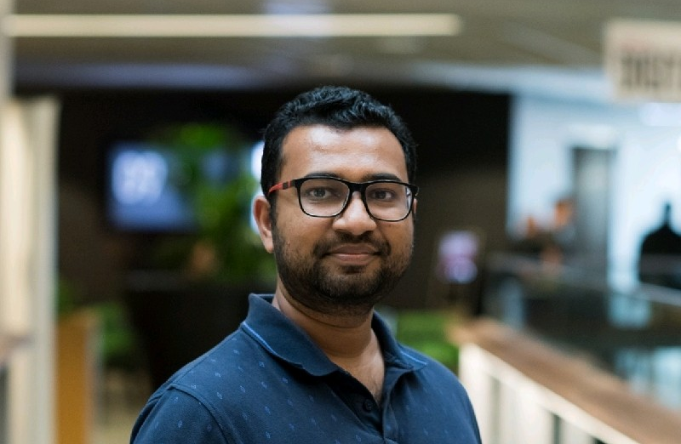

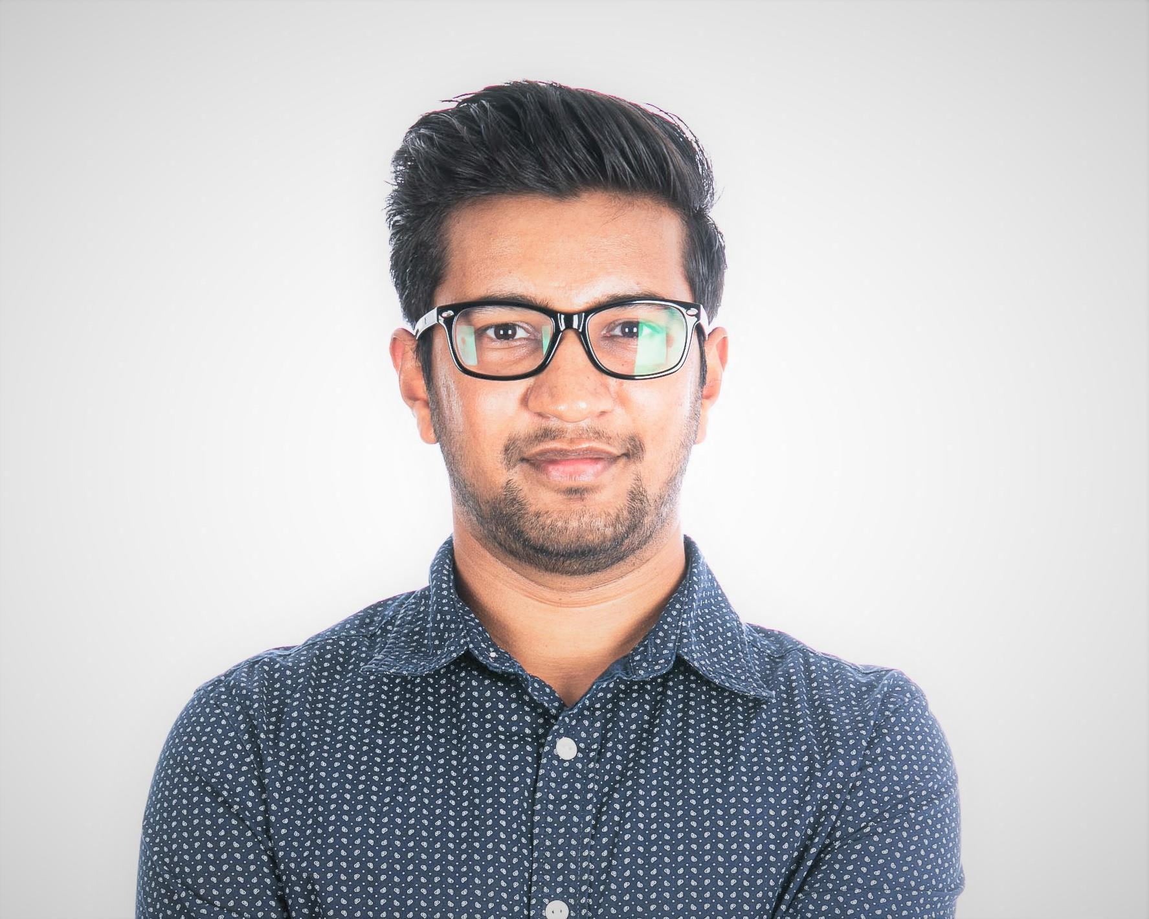
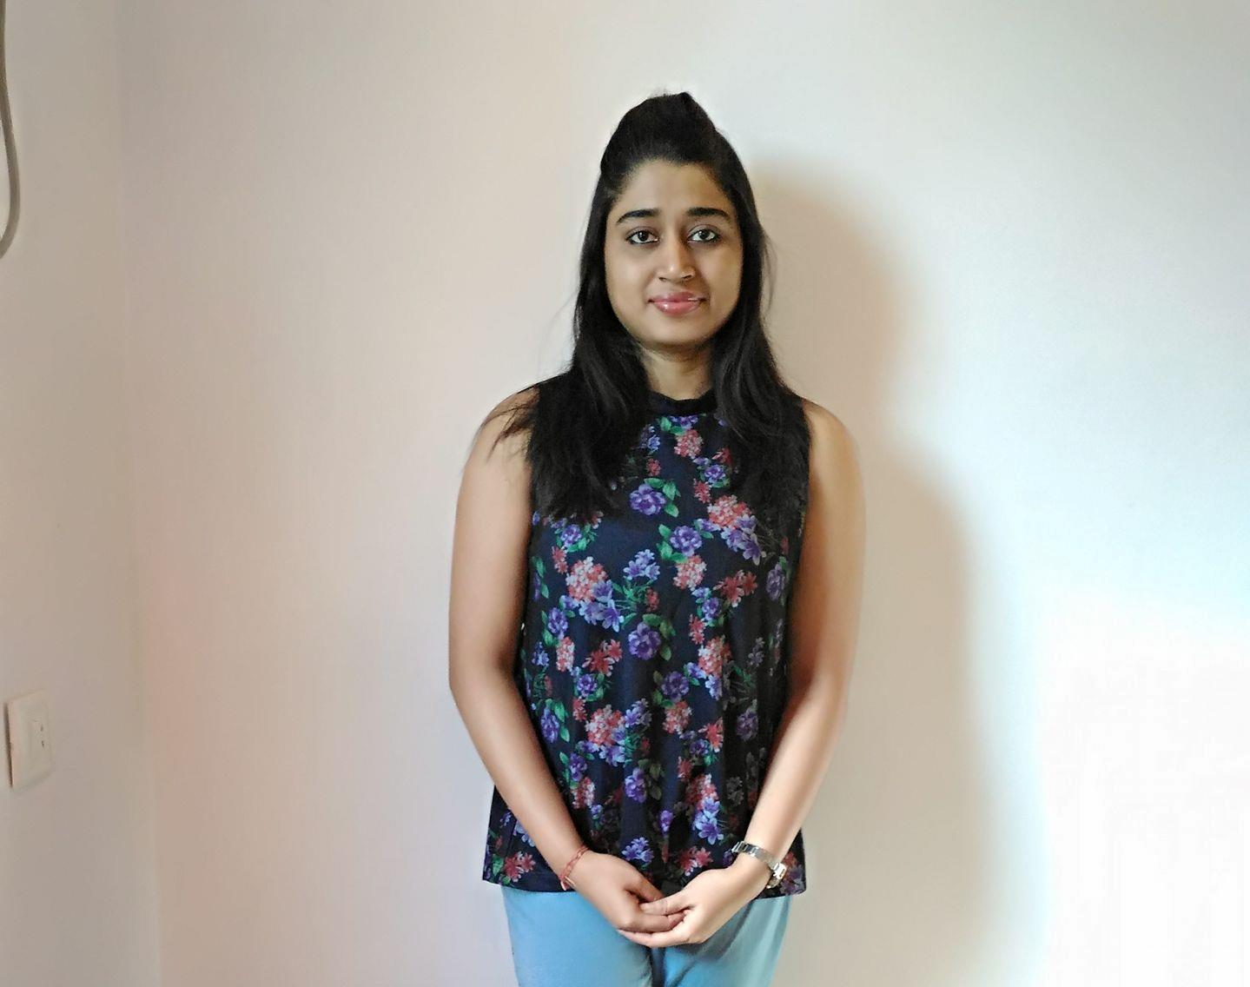
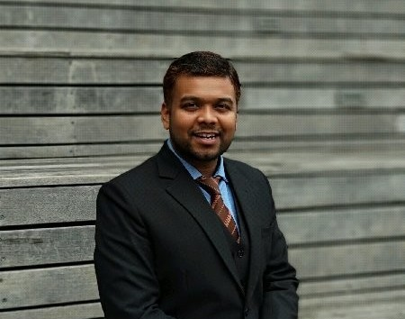
Saurabh Jain
https://www.linkedin.com/in/saurabh-jain-68040952
Jubin Savla
https://www.linkedin.com/in/savlajubin
Saket Jain
https://www.linkedin.com/in/saketj32
Anikesh Sasmal
https://www.linkedin.com/in/anikesh-sasmal-20031988
Swetalina Nayak

Slide 3
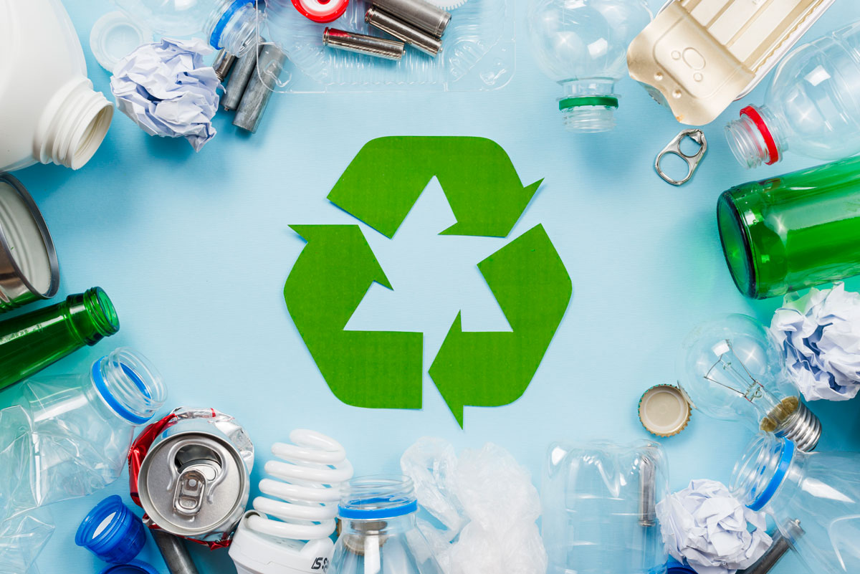

Challenge : Track and trace: help end plastic waste
Plastics contaminate Australia’s lands and seas, and challenge our industries, communities and decision makers with an exponentially growing problem. How might we enable and empower Australians to help de-plasticise our country and report plastic waste in our environment for a healthier future.

Slide 4
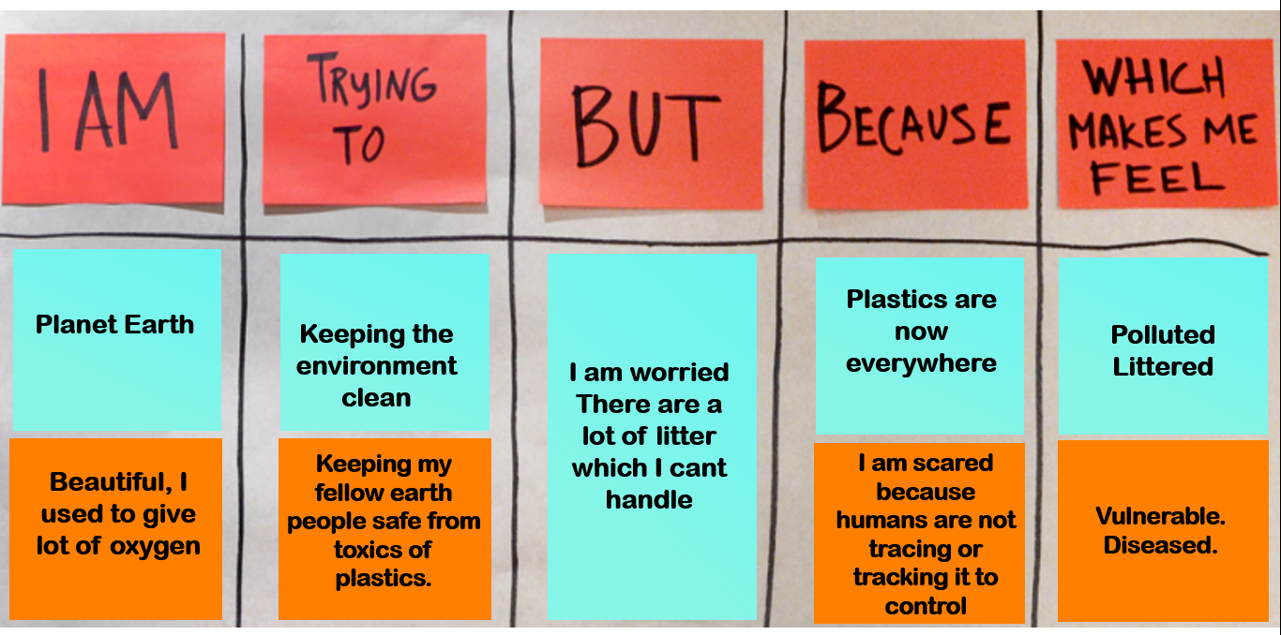
The Problem Statement

Slide 5


The Design – Smart Bin And a Rewarding Bin
An Experience Innovation.
Planet Earth needs help !
Plastics are contaminating our land and seas.
“Our industries, communities and decision makers are facing this challenge with an exponentially growing problem”
DESIRABILITY
VIABILITY
PEOPLE
BUSINESS
FEASIBILITY
TECHNOLOGY
Can we empower members of the community to report, measure and identify plastic waste in their environment ?
Notes:
Ki: A packaged solution for the SMEs and large businesses that leverages the power of Artificial Intelligence, mobility solutions, virtual reality, MANA and IoT to reduce the loss of revenue due to machine failures and hasten the process of machine repair with precision and accuracy.
Do: Infosys must apply design thinking principles to design the product and then leverage the skillset of Infoscions from units of mobility (native app programming), Data and Analytics (MANA and AI) and Infosys Labs (for virtual reality and IoT). The product will be sold to SMEs without MANA and AI features to reduce the cost for SMEs. Large businesses and manufacturers of machines can leverage MANA and AI features by paying extra for these premium features.
Ai: This way, we can unite the powers of AI, MANA, IoT, mobility and virtual reality to create a seamless experience for the engineers at SMEs and large business while addressing machine failures, thus saving time, money and productivity of industries.

Slide 6

The Journey
Meet Tyler and Lisa
https://youtu.be/Mu-Wke2QVoY

Slide 7
UX
DESIGN
Defining Experiences…

Slide 8
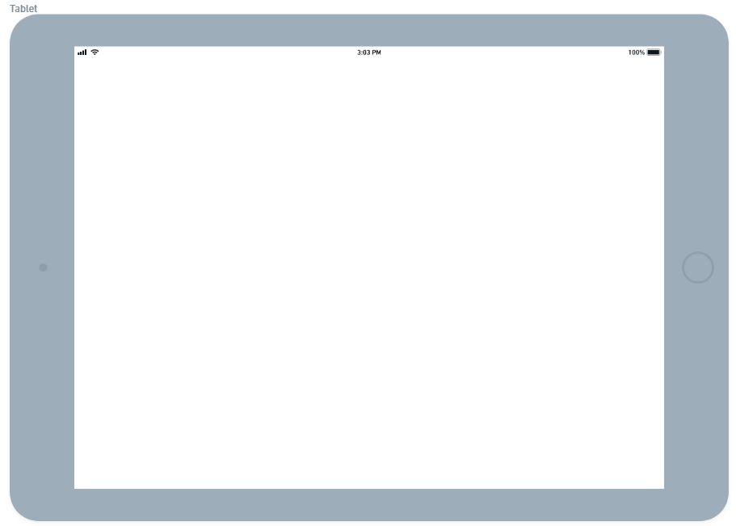
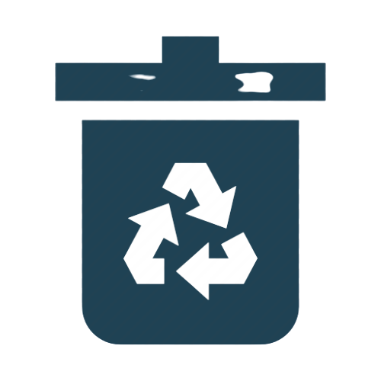

On Smart Bin Display
REWARD BIN
Get amazing rewards by help tracing plastic wastes.
Get Started

Slide 9
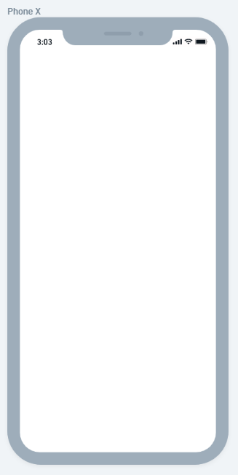




RewardBin Mobile APP
Hello Tyler!
236 Points
Scan at the RewardBin KIOSK
Fill in your latest disposal data for more rewards.

Slide 10

Categorize your plastic wastes according to its sources. Gain 100 points for every 1 kg plastic wastes.
In a hurry!

Slide 11



Select all the possible sources of your plastic waste from different categories then dump the garbage to the bin.
Food (Includes take away boxes, milk bottle, straws etc.)
Life Style (Includes beauty products, toiletries packaging etc.)
Health Care (Includes cough syrup bottle, sanitizer bottle etc.)
Categories
Selection
Next

Slide 12

Thank you for your contribution! You have disposed 0.25 kg of plastic wastes. We are pleased to inform you that you have earned 25 RewardBin Perk Points.
Done

Slide 13
Categorize your plastic wastes according to its sources. Gain 100 points for every 1 kg plastic wastes.
In a hurry!

Slide 14
Categorize your plastic wastes according to its sources within 24 hours using mobile the RewardBin app. Gain 50 points for every 1 kg plastic wastes.
I am happy with minimum points! Gain 20 points for every 1 kg plastic wastes.

Slide 15
Thank you for your contribution! You have disposed 0.25 kg of plastic wastes. We are pleased to inform you that you will earned 12.5 RewardBin Perk Points when you will submit the form in your RewardBin app.
Done

Slide 16
Categorize your plastic wastes according to its sources within 24 hours using mobile the RewardBin app. Gain 50 points for every 1 kg plastic wastes.
I am happy with minimum points! Gain 20 points for every 1 kg plastic wastes.

Slide 17
Thank you for your contribution! You have disposed 0.25 kg of plastic wastes. We are pleased to inform you that you have earned 5 RewardBin Perk Points.
Done

Slide 18

Hello Tyler!
236 Points
Scan at the RewardBin KIOSK
Fill in your latest disposal data for more rewards.

Slide 19
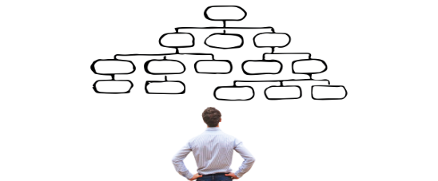


.
Select all the possible categories.
Food (Includes take away boxes, milk bottle, straws etc.)
Life Style (Includes beauty products, toiletries packaging etc.)
Health Care (Includes cough syrup bottle, sanitizer bottle etc.)
Categories
Selection
Next

Slide 20

Congratulations! We are pleased to inform you that you have earned 25 RewardBin Perk Points.
Done

Slide 21
Endless Possibilities – How can we scale.
All Re-usable wastes gets Accepted and rewarded
Scale this to protect our waterways
Connect to Real Time Garbage smart bin
More Communities
Possibilities

